Slide 1

Using Text-Level GNNs to Classify Explanations
Joe Shymanski
joe-shymanski@utulsa.edu

Slide 2
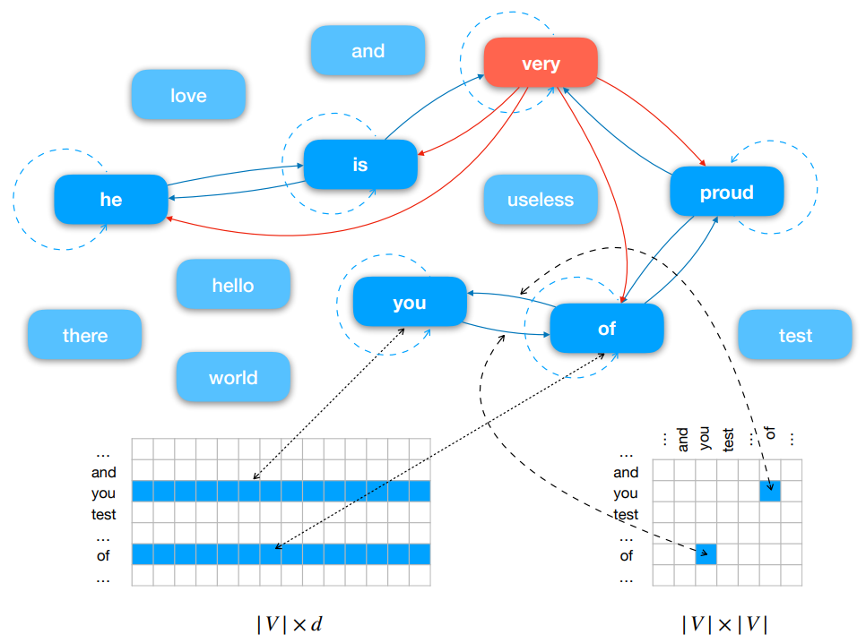

Slide 3
Implementation Details
Dataset Stats
102 explanations
9.74 tokens per explanation
More examples needed
2 labels, evenly split
51 actionable, 51 placebic
Training and testing sets, ~70/30 split
72 training, 30 testing
Validation set, 20% of training set
GNN Parameters
Batch size: 32
Minimum frequency: 2
Optimizer: Adam
Learning rate: .001
Weight decay: .0001
Warm up epochs: 100
Maximum epochs: 300
Early stopping patience: 10 epochs
Early stopping criteria: Validation loss

Slide 4
Example Explanations (Cleaned)
Actionable
pinning the knight to the king is the best move
this forks the opponent s best piece with the king
check the black king with the rook and then capture the free bishop
Placebic
this move leaves your opponent with an unfavorable response
your other options are not nearly as beneficial
pushing your pawn here is better than any other possible move

Slide 5
Embedding Size

Slide 6
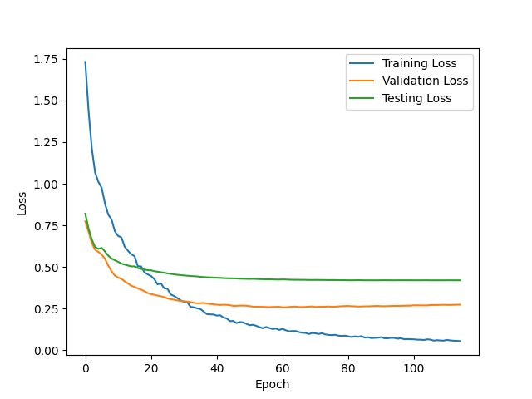
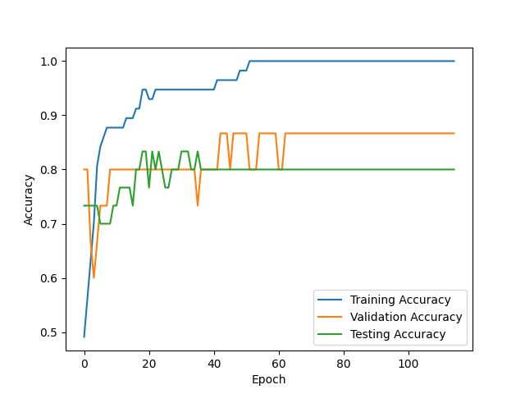
embedding_size=50

Slide 7
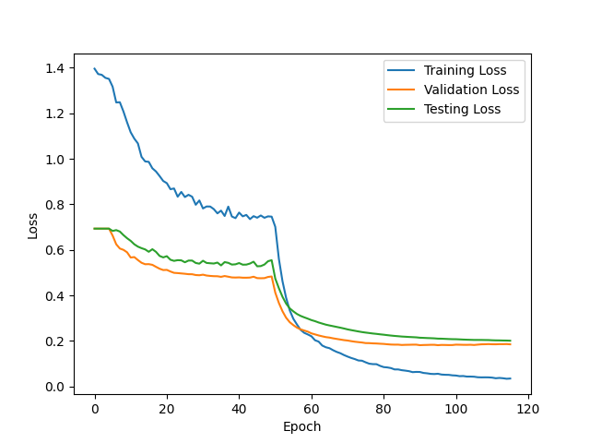
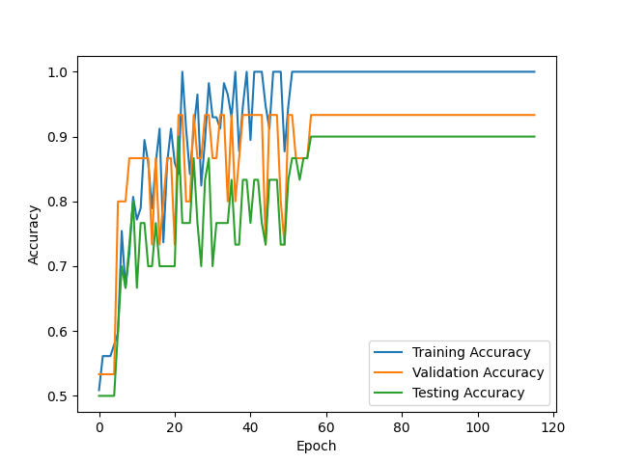
embedding_size=300

Slide 8
P

Slide 9
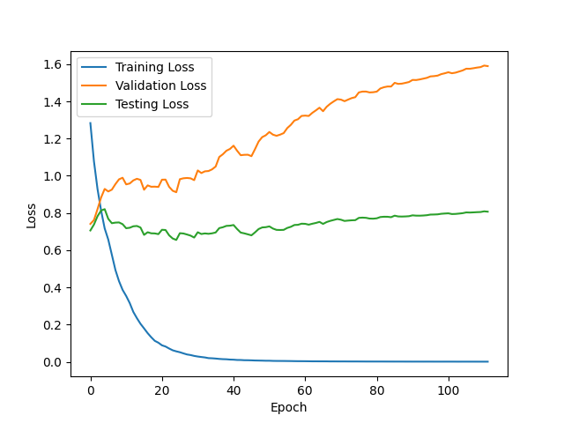
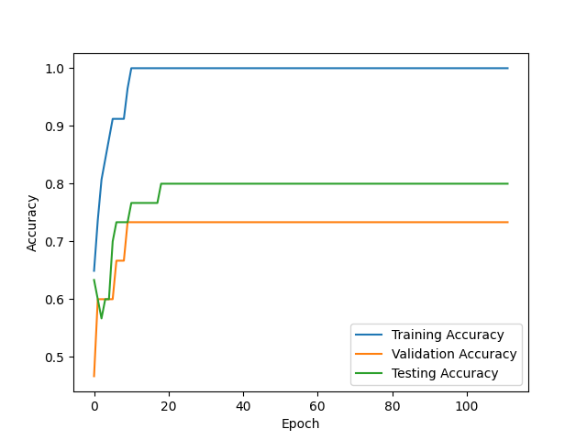
p=0

Slide 10
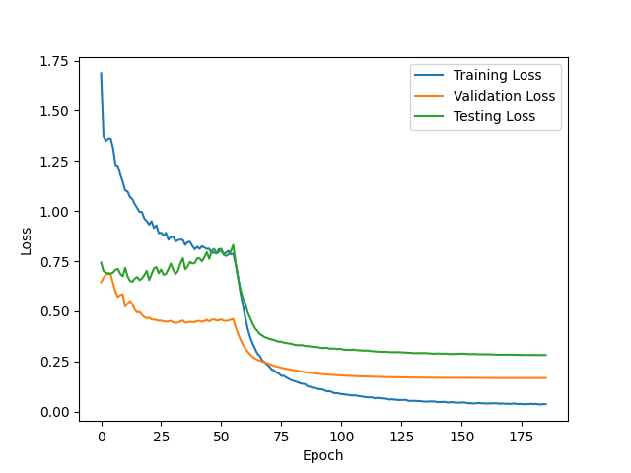
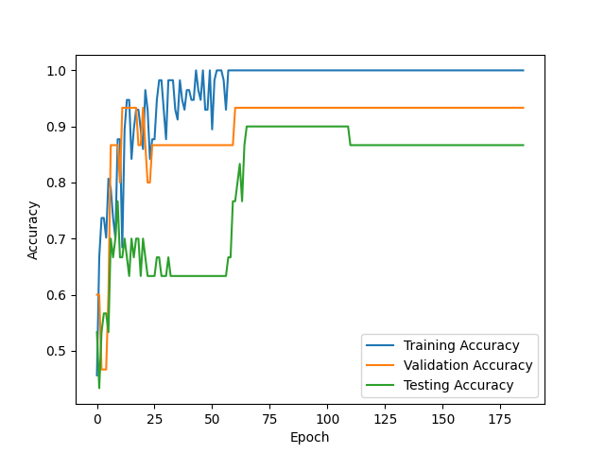
p=1

Slide 11
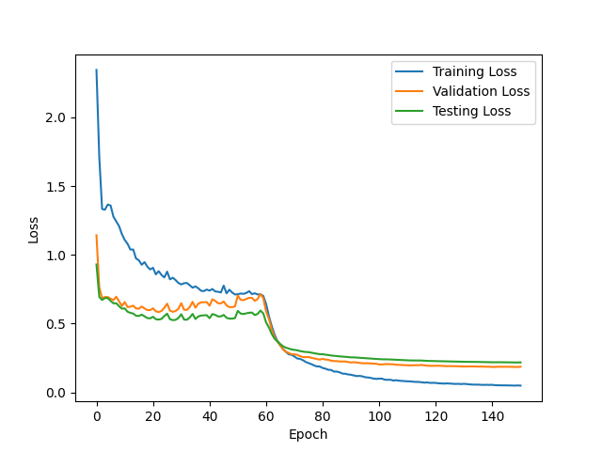
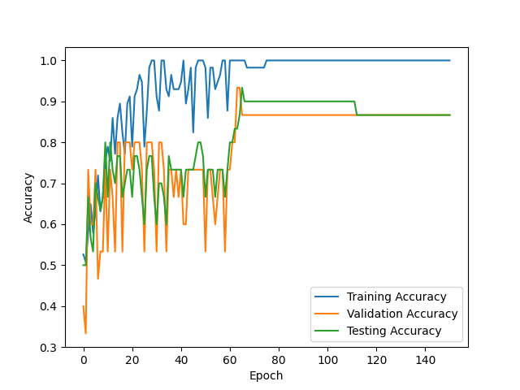
p=2

Slide 12
p=3

Slide 13
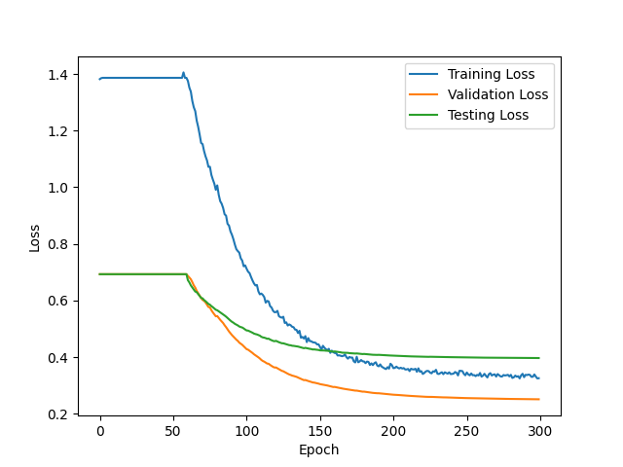
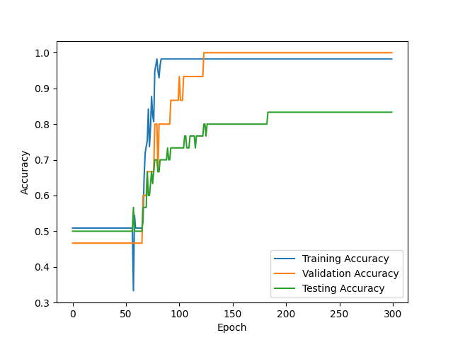
p=4

Slide 14
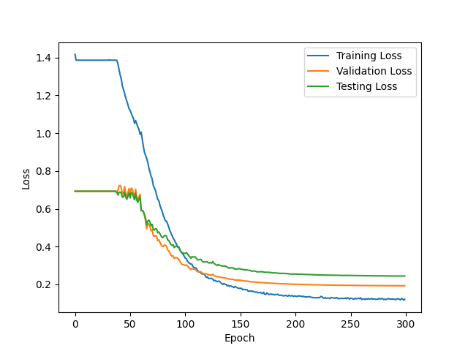
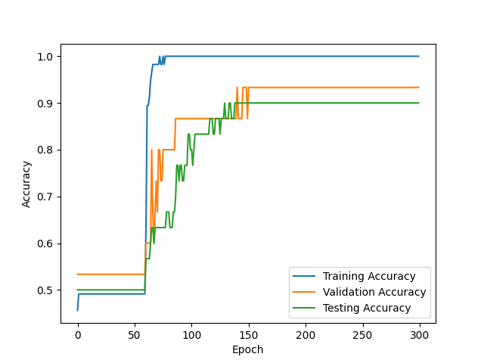
p=5

Slide 15
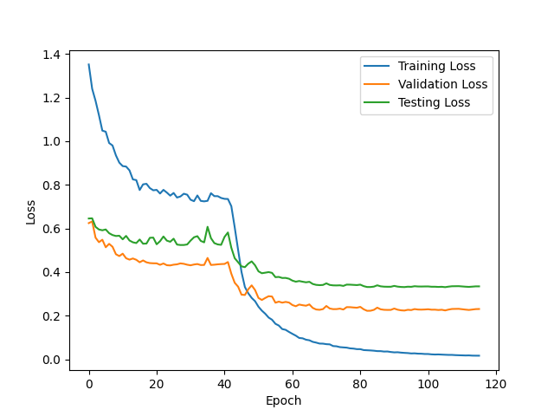
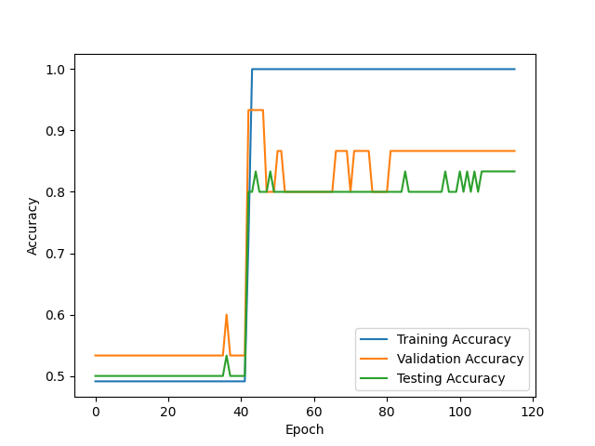
p=6

Slide 16
99.7, 91.7, 88.0
Training Accuracy (%), Validation Accuracy (%), Testing Accuracy (%)

Slide 17
References
Cynwell. (n.d.). Cynwell/text-level-GNN: Text level graph neural network for text classification. GitHub. https://github.com/Cynwell/Text-Level-GNN
Huang, L., Ma, D., Li, S., Zhang, X., & Wang, H. (2019). Text level graph neural network for text classification. arXiv preprint arXiv:1910.02356.
Pennington, J., Socher, R., & Manning, C. D. (2014, October). Glove: Global vectors for word representation. In Proceedings of the 2014 conference on empirical methods in natural language processing (EMNLP) (pp. 1532-1543).

Slide 18
Questions?
Joe Shymanski
joe-shymanski@utulsa.edu

